Slide 1
HPS Slow Controls Overview
By Hovanes Egiyan , Jefferson Lab

Slide 2
EPICS
Experimental Physics and Industrial Control System
Free Open Source software based on C with a large user base
  Main controls framework of CEBAF
Server/Client model:
  Input/Output Controller (IOC) serves variables over Ethernet using ChannelAccess protocol.
  Clients on different hosts communicate with IOC(s) displaying, modifying, archiving values.
Applications are usually written in form of EPICS record database
  Each EPICS record type has a variety of fields, like VAL, SCAN, STAT.
  Each record type has a set of functionalities, hence function block programming
  Individual EPICS record instances (PVs) can have different processing
    Periodic, S/W Event, Passive, H/W Interrupt
EPICS community provides various tools, like display management, alarm handling, archiving of variables.

Slide 3
Control Screens, Alarms etc
CLAS6 used MEDM EPICS extension for display management
  Very simple, small capabilities
  Outdated packages from 90s
CLAS12 and GlueX are considering using CSS BOY for display management
  Part of Eclipse-based toolkit
  Provides a large number of widgets
  Allows to run scripts that affect widget and container properties
CLAS6 used an old EPICS alarm handler ALH
  Configurable through a text file
  Old packages from 90s
CLAS12 and GlueX are considering using CSS BEAST for alarm systems
  Integrated with CSS
  Configurable via MySQL database
CLAS 6 used StripTool EPICS extension to display time evolution of PVs
  Standalone packages, old technology, works well
CLAS12 and GlueX are considering to use CSS BOY
  Integrated with display managements and alarm system
Can use what CLAS12 decides to use for EPICS archiving
  MYA supported by the JLab accelerator division
  RDB Archiver integrated with CSS

Slide 4
HPS Slow Controls Applications
High/Low Voltage control
  Beamline, ECAL, SVT, Muon Detector
  Need mostly to develop control and alarm screens
  Interlock SVT power supplies
Motion control
  Harps, SVT scans, target, collimator, beam blocker
  We need to develop the applications for SVT scans, others are pretty much ready
Temperature monitoring
  ECAL and SVT temperature monitoring, chiller for SVT, interlock for SVT
  Can use a different approach to signal IO like PLC readout
Monitoring of scalers
  Main feedback from detector components
  Need to develop EPICS support for JLab modules
Magnet power supplies and beamline
  Use existing power supplies and control, almost no changes is expected here.
  May need some work on GUIs if we use a new display management framework
  New VxWorks and EPICS versions

Slide 5
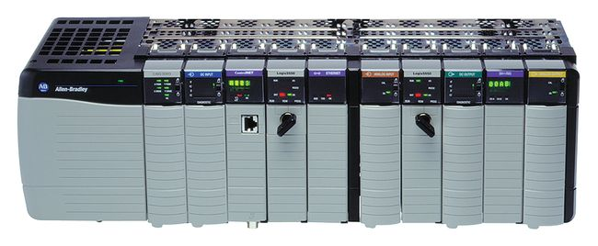
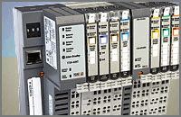
PLC for Analog and Digital I/O
We can use Programmable Logical Controller for Analog and Digital IO
  Thermocouple inputs
  Mass flow meter, vacuum chamber pressure readback
  Potentiometer from motorized stages
  Interlock statuses
  Any other last minute requests
Allen-Bradley PLCs are easily interfaced with EPICS through Ethernet (EthernetIP protocol).
  Used in Hall D for the lowest layer of the control system
Programming PLC requires expertise
  If only used to obtain the reading for EPICS then not much PLC programming will be required.

Slide 6
Voltage Control
ECAL and muon system HVs will be provided by CAEN modules housed in SY1527 chassis
  Used this in HPS Test, CLAS6, will be used by CLAS12 and GlueX
Biases and LV for SVT were provided by dedicated CAEN modules
  We wrote EPICS support, resulted in an awkward and slow system.
  Unsupported by manufacturer, complicated trip and alarm detection.
Wiener MPOD-based HV/LV system for SVT biases and LV
  SNMP-based EPICS interface exists, used by Hall B and Hall D
  Hall B is procuring some HV/LV boards and chassis for CLAS12 SVT
Can combine both CAEN and Wiener into a single EPICS IOC running on one of the Hall B online Linux servers, or can run two separate IOCs.

Slide 7
CAEN SY1527 and Wiener MPOD
EPICS support for CAEN
  From CLAS6 slow controls
  From Canadian Light Source
    Hall D will use this one, modified by Nerses
    Reads the content of each chassis and configures EPICS IOC DB automatically
EPICS support for MPOD
  MPOD voltage parameters are obtained using SNMP driver for EPICS
  Small MPOD specific driver written to autoconfigure the IOC by reading the content of the chassis.
Both of these pieces of hardware will be used in CLAS12 and GlueX

Slide 8
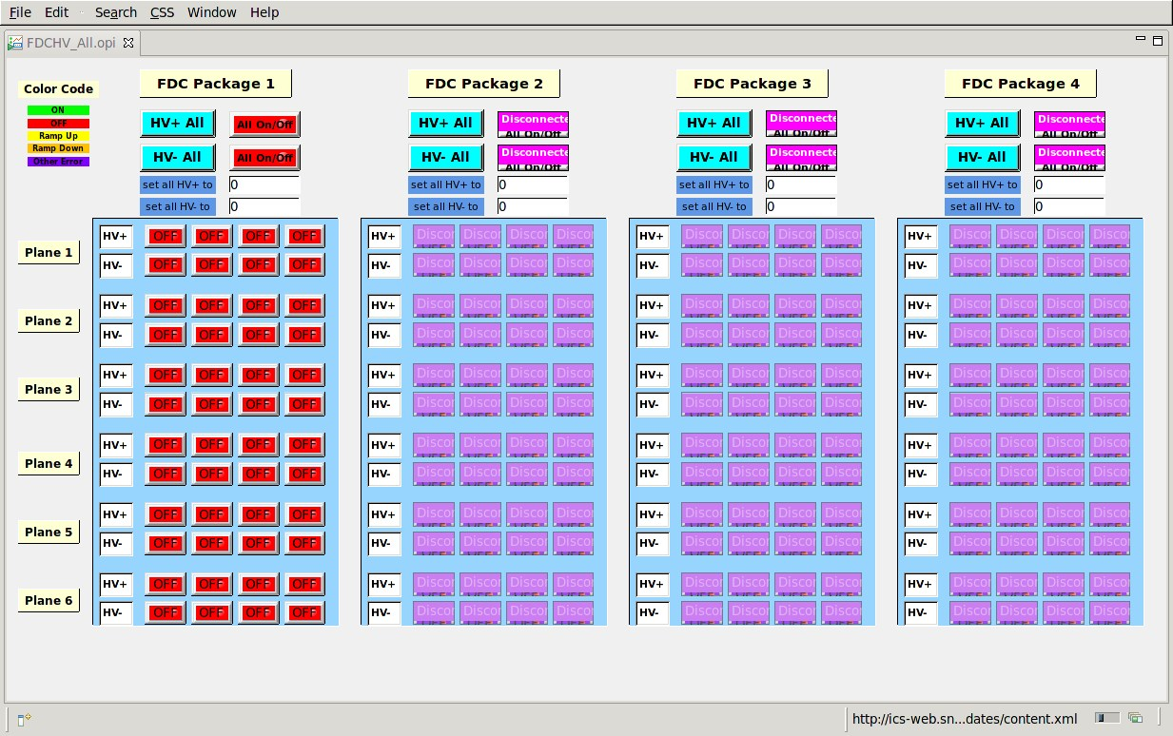
CAEN HV Control Screen with CSS

Slide 9
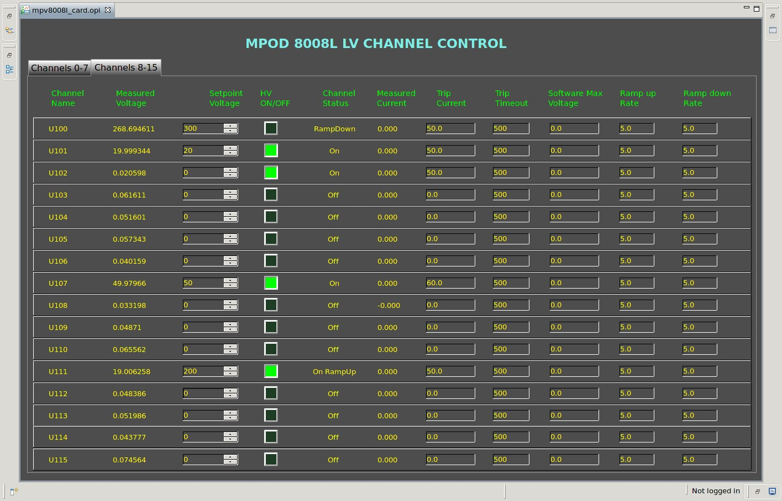
MPOD LV Screen with CSS BOY

Slide 10
MPOD Chassis and Boards
HPS will need 2 chassis , 14 MPV8008 boards ,and four EHS F205-F boards.
Many labs use these power supplies as standard equipment.
  Hall D already has experience with using MPOD based chassis
    Used them during 2012 beam test of GlueX miniBCAL
      No hardware interlocks are required for GlueX, no in-house experience with this.
      Interlocks for voltages needs to be designed.
CLAS12 SVT will use thse power supplies
  They may have some (~2HV , ~4LV , 1 chassis) spares in fall of 2014
    Depends on CLAS12 SVT progress
    May need to purchase some items for HPS
Interlocks can be either on board level or chassis level
  Chassis with a controller with a 2-pin LEMO connector
    All channels on a chassis can be ENABLED by a TTL level (ramp down if zero level)
  Boards can have option for interlock:
    ISEG EHS HV modules have SL LEMO connector for safety loop (ENABLE) requiring 5mA current to enable channels on the board. Fast shutoff of all channels on the board there is no current.
    Wiener MPV 8008 modules can have DSUB-37 with ENABLE per group of 4 channels. If TTL level is zero all channels are turned off.
    Wiener MPV8008 modules have safety loop connectors for DSUB-37 connector for groups of 4 channels. If the loop is open the 4 channels are turned off.

Slide 11
SVT Interlocks
SVT cooling, power and vacuum need to be interlocked to avoid damaging SVT equipment. Power and coolant flow needs to be shut off when there is a problem with:
  SVT temperature
  Pressure in the vacuum chamber
  Flow in the cooling line
  Beam quality?
    Either need “the signals” or can only be software interlocks
We need to identify exactly what the interlock system needs to do in 2014
  What are the input signals?
  What is being monitored by EPICS (the input and output status).
Who and how the hardware interlocks will be implemented?
  Can ask Krister to design and build a dedicated chassis .

Slide 12
Stepper Motor Control
The control modules from OMS has EPICS interface.
  “motor” EPICS record type
We did not use any of the HPS motorized stages during 2012 test run.
  Interfacing to EPICS should be pretty straightforward since the hardware was selected Hall B controls framework in mind.
  For potentiometer readout we need analog input channels.
An application needs to be written if the motor is expected to do any automated motion
  Create EPICS database or state code to set the appropriate fields of the motor record at appropriate times.
Control Module
In VME crate
Driver and PS Box
Stepper Motor

Slide 13
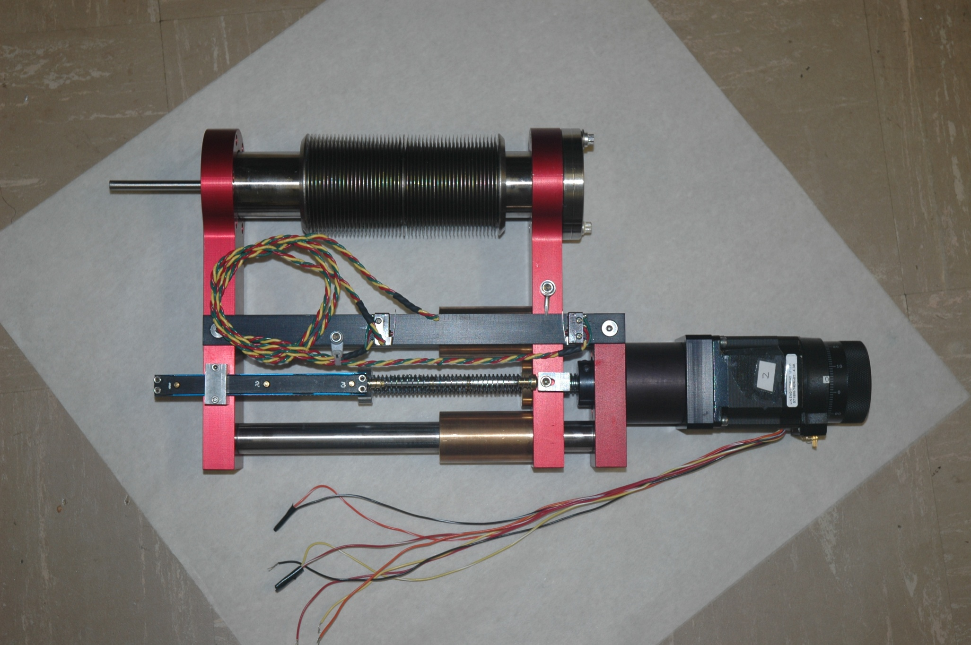
HPS Stepper Motors
Limit switches
Limit switch wires
Stepper motor
Encoder pins
Potentiometer
Stepper motor power wires

Slide 14
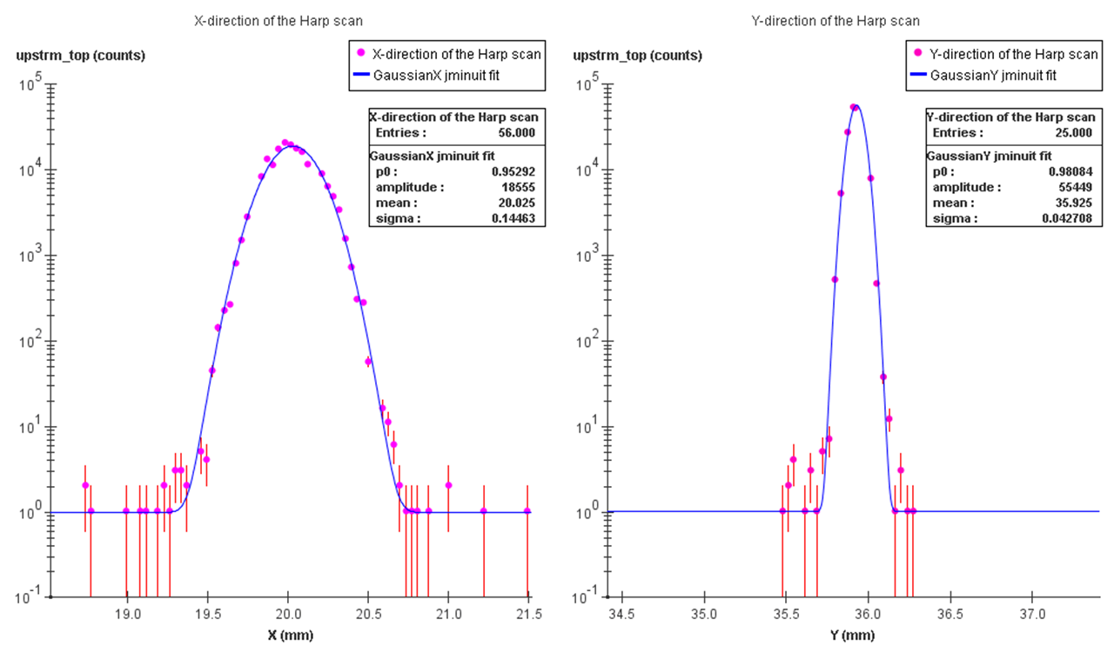
Scans
HPS needs 3 harp scans (3 motors):
  Standard Hall B 2C21, 2c24, and 2H00 harps
  Hardware and software mostly exists
Scans with SVT wires (2 motors):
  New scans that will require
    Detector channel that can be connected to scalers
      Beam halo counters downstream of SVT
      ECAL channel connected to a discriminator and scaler, unlikely
    New analysis software to determine the X- and Y- position of the SVT frame.

Slide 15
Temperature Monitoring
ECAL electronics needs to be thermally stabilized, temperatures need to be monitored.
  In 2012 the monitoring was done using Omega thermocouples and RS-485 readout modules.
  If new thermocouples are installed can use PLC readout modules.
SVT board temperature is monitored using temperature sensors readout by SVT DAQ when DAQ is running
  Interfaced with EPICS, but not reliable to be used in interlocks or alarms.
  We also used thermocouples on the SVT vacuum chamber to monitor temperature
SVT cooling requires a chiller that needs to be operated remotely
  Primex chiller did not match well the SVT needs, caused some confusion
  HPS will procure a dedicated chiller with remote control that can be interfaced with EPICS, for instance through RS-232.
The SVT vacuum chamber and ECAL sensors can be read out using PLC
  Hall D uses Allen-Bradley PLC for IO in slow controls
  EPICS support exists for A-B ControlLogix and CompactLogix PLC
  HPS probably can borrow Rockwell software licenses from Hall D for short amounts of time.

Slide 16
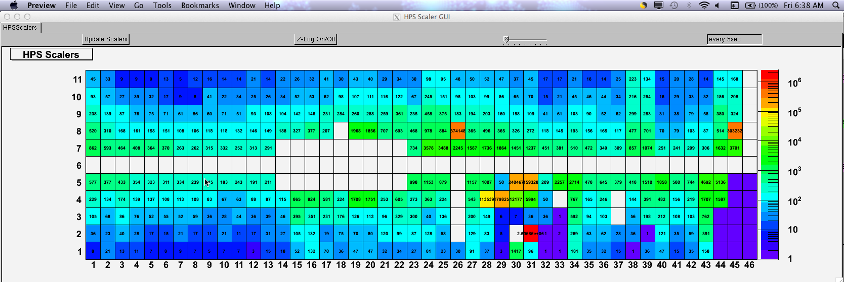
Scaler Monitoring
It is very important to have as much scaler information displayed online as possible, waiting for offline analysis may lead to time waste.
During spring run we had scaler values for ECAL in ROOT
  Sergey wrote the software to read the scalers from the discriminators and plot them.
It is desirable to have scalers from discriminators, FADC, CTP, SSP in EPICS
  Can be view from many locations
  Can be archived
  Configuration parameters for the boards should be archived as well.

Slide 17
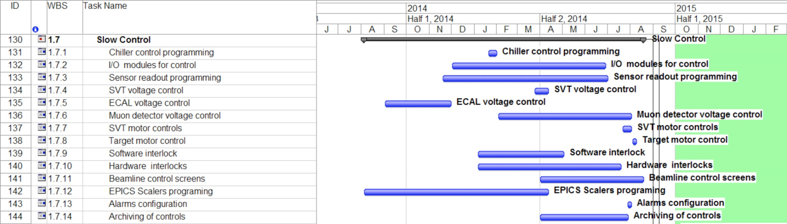
Schedule (from the proposal)
Official activities start this summer
  Actual start time will also depend on hardware availability
Need to identify people for the tasks in the schedule
  Slow controls mailing list have been created using JLab mailman: hps-controls@jlab.org
  Someone from accelerator for EPICS programming? Chiller, PLC programmer?
  Steep learning curve for either EPICS and PLC is expected for physicists.
Biweekly meetings starting this month

Slide 18
Summary
Upgrades in some areas, introduce new features
  SVT power, interlocks
  Signal I/O with PLC
  Motors for SVT and for target
  New chiller
  Use CSS for display management and alarms.
Activities will start this summer
  Will start bi-weekly meetings this month.
  Should have a good description of work and a plan by fall
  Will identify collaborators volunteering to work on controls.
  Should have a review sometime this fall
Need input from detector components, can be presented at the meetings
  Description of the hardware and its functionality
  Parameters to monitor and control, and how
  Existing software/firmware description
  Parameters that need archiving
  Alarm conditions
  Software interlocks
  Backup/restore requirements

Slide 19
End
Thank You !

Slide 20
Scans procedure
A harp is moving continuously at ~0.5mm/s speed across the beamline
  The control modules for the motors are in a VME crate.
VME scalers attached to the beam halo detectors or other detectors are continuously read out.
  In Hall B scaler readout happens on VME bus.
Every few millisecond both motor position and scaler readings are written to the disk.
The scaler readout and harp motion needs to be synchronized.
  The level of synchronization depends on the speed of the harp and required precision in the beam position.
  Having both motors and scalers and motor controller on the same VME bus is sufficient.
  If these are in different crates communicating over Ethernet:
    The motor control module needs to send out strobe signals for scaler latching.
    Scan needs to progress “sufficiently” slow, scans take long time

Slide 21
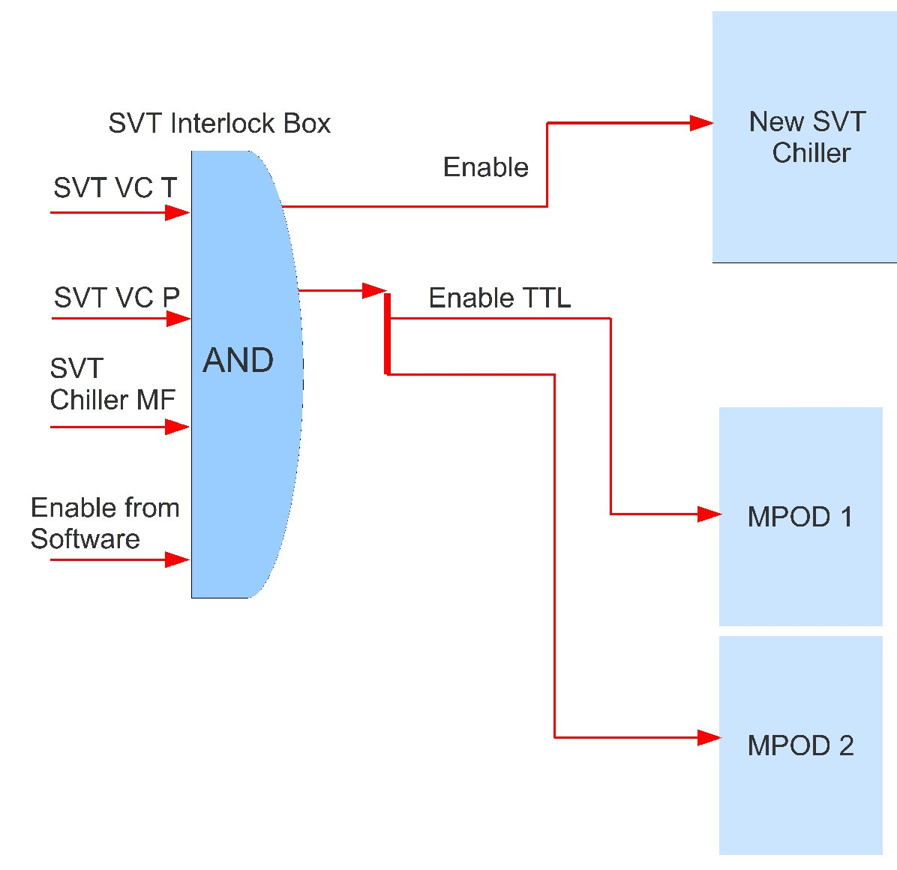
SVT Interlocks with ENABLE
Might be just enough to use ENABLE input to the DB-9 connector on the controller of the MPOD crate
SVT will need to have an input got either of ENABLE or INHIBIT signal.
Chassis to accept 3 analog inputs
  Vacuum chamber pressure
  Vacuum chamber temperature
  Chiller coolant flow
Chassis to accept a TTL level from EPICS
Need to build a dedicated chassis for the SVT interlocks.

